Slide 1

AtliQ Supermarket Promotions & its Impact Analysis
Presented by :- Divya Mashruwala

Slide 2
Agenda
Problem statement
Data Walkthrough
Understanding the KPI’s & dashboard overview
Ad-hoc requests & its solution
Other visualizations with insights & recommendations
Presentation Title

Slide 3

Problem Statement
AtliQ Mart is a retail giant with over 50 supermarkets in the southern region of India. All their 50 stores ran a massive promotion during the Diwali 2023 and Sankranti 2024 (festive time in India) on their AtliQ branded products.
Now the sales director wants to understand which promotions did well and which did not so that they can make informed decisions for their next promotional period.

Slide 4
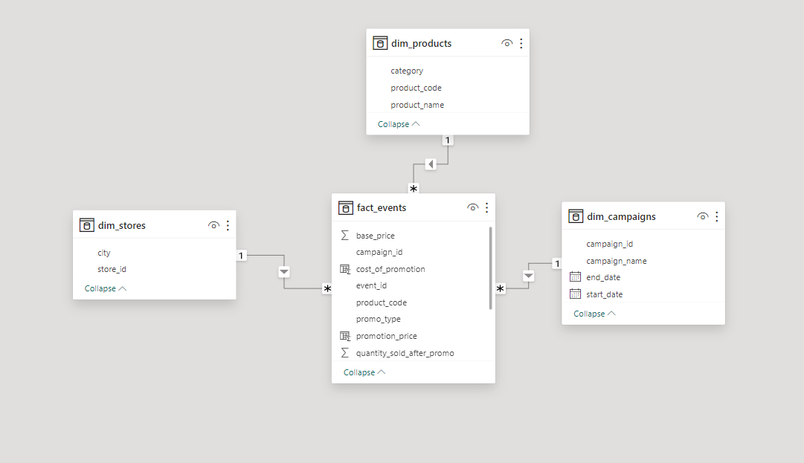
Data Walkthrough
The data model consists of 4 main tables:
dim_products
dim_stores
dim_campaigns
fact_events
dim_products:- This table consists of all the necessary information about the products.It includes product id, product name (specific description), category of product.
dim_stores:- This table consists of the information of stores of Atliq located in different cities where Atliq has its supermarket.
dim_campaigns:- This table gives us the idea about the promotion campaigns being run by Atliq in their supermarkets.
Fact_events:- It gives information about unique sales event of Atliq supermarket.
Each record gives the info about product id , store id, base price, promo offer applied on it , as well as quantity sold before & after promotion.
AtliQ supermarket promotions & its Impact Analysis

Slide 5
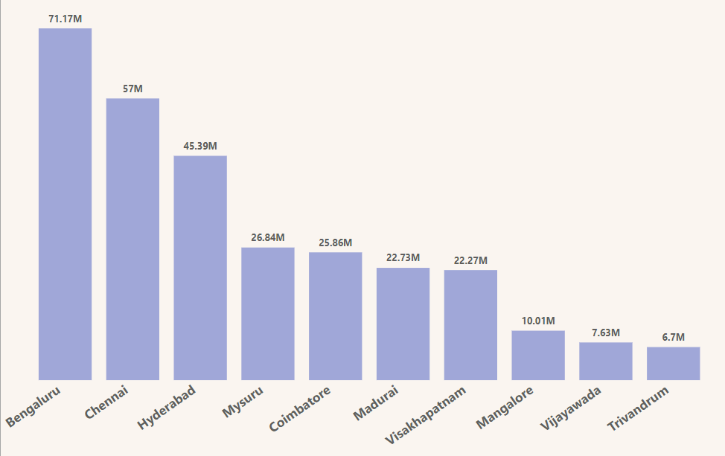
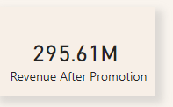
Understanding the KPI’s
KPI’S are key performance indicators. It is an important metric which helps us to track progress of our specific goal or objective.
Very important insights can be derived from this KPI’s to drive our business in more better way.
The important KPI’S which we have used to gain insights of the sales performance of Atliq by different promotion campaigns are as follows
Revenue After Promotion:- It can be defined as the revenue generated by Atliq sales after the application of promotion campaigns which are Diwali 2023 & Sankranti 2024.
Formula: Quantity sold after promotions * promotion price per unit
Here promotion price is calculated as per the promotion offered on product.
Promotion price = base price – base price * discount percentage
Total Revenue after promotions in Millions
Bengaluru (71.17M), Chennai (57M) & Hyderabad (45.39) generated most revenues after the promotion campaigns
AtliQ supermarket promotions & its Impact Analysis

Slide 6
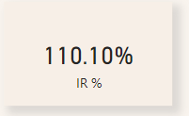
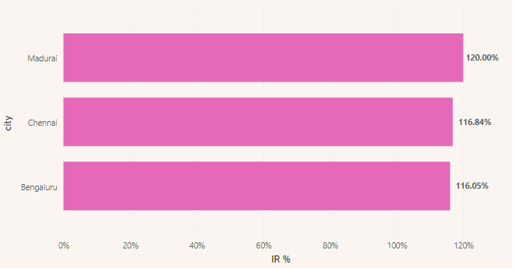
Understanding the KPI’S
Incremental Revenue :- It can be defined as the increased revenue of Atliq stores due to promotional campaigns.
Formula:- Revenue after promotion – Revenue before promotion
Incremental Revenue % :- It is an important metric which indicates the impact of promotional campaigns in various cities with different categories of products.
Formula:- (Incremental Revenue / Revenue before Promotion) * 100
IR% of 110 means the revenue has increased 110% more compared to revenue before promotions.
Madurai tops the list with the impact of promotions on the revenue generated after promotional campaigns followed by Chennai & Bengaluru.
We can also check the IR% for city by certain promotion offers, categories, & for campaigns by applying filters.
Top 3 city by IR%
AtliQ supermarket promotions & its Impact Analysis

Slide 7
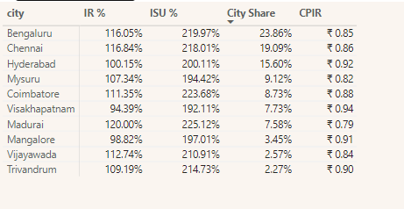
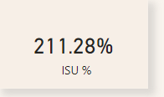
Understanding the KPI’S
Incremental Sold Unit % :- It can be defined as percentage of increase in sales of units of product due to promotions at Atliq stores.
Formula:- (Incremental quantity / quantity sold before promotion ) * 100
ISU% of 211.28 means the percent hike in quantity of units sold after the promotions as compared to quantity sold before promotions.
City Share:- It means the contribution of revenue of one city to overall Atliq revenue generated.
City share % = city revenue generated / total revenue generated
Bengaluru, Chennai, Hyderabad & Mysuru are the key source of revenues for Atliq as per their numbers & city share.
CPIR :- stands for cost per incremental revenue
CPIR= cost of promotion / incremental revenue
CPIR means cost of promotion for each additional rupee generated after promotions.
The lower value of CPIR shows that the promotion is very efficient for us.
AtliQ supermarket promotions & its Impact Analysis

Slide 8
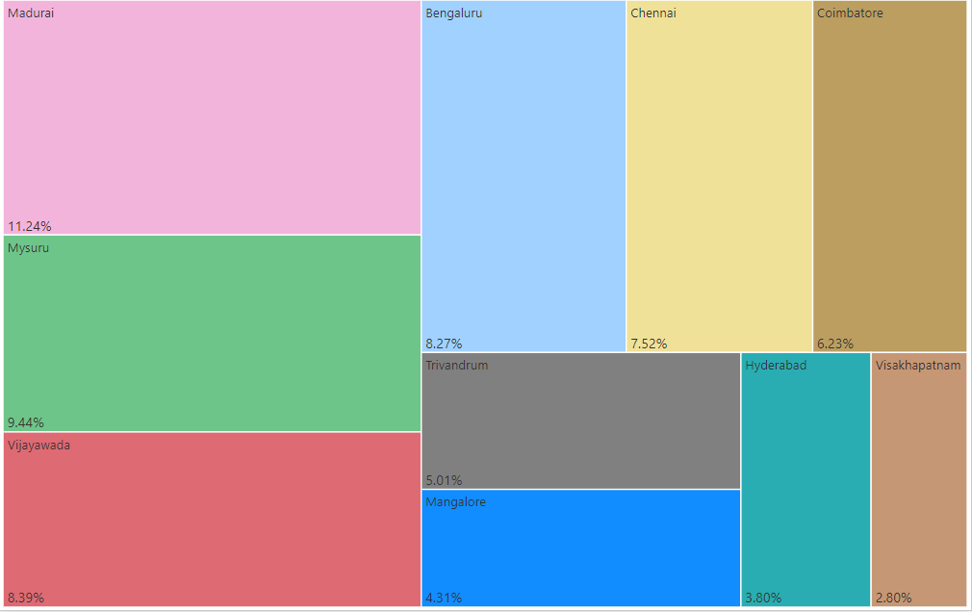
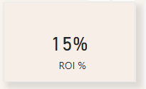
Understanding the KPI’S
Return on investment (ROI % ) :- It helps to calculate the profitability of promotional campaigns with the cost of promotion invested.
Formula:- ( Incremental revenue – cost of promotion ) / cost of promotion *100
If ROI is positive it means the promotional campaign generated more compared to the cost of promotion invested.
Profit Margin:- It is defined as the percent of promotion profit with respect to the revenue generated after promotions.
Formula:- promotion profit / Revenue after Promotion * 100
(promotion profit = incremental revenue – cost of promotion )
A positive ROI means the promotion campaign have generated profit as per cost of money invested.
It means for every rupee invested the profit generated is 1.15 rupee.
Madurai has the highest profit margin 11.24 % followed by Mysuru with 9.44 %
AtliQ supermarket promotions & its Impact Analysis

Slide 9
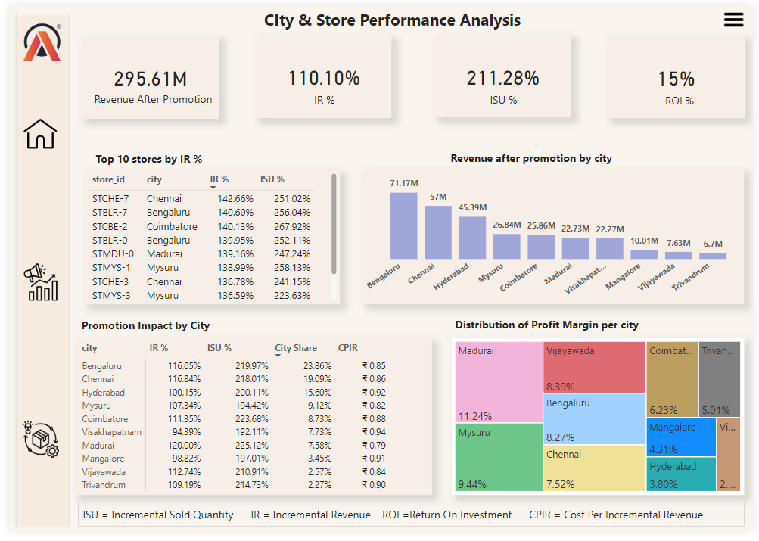
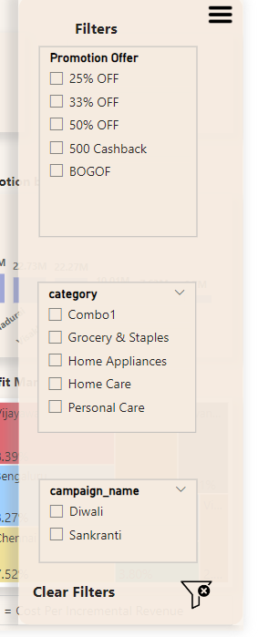
Dashboard Overview
This is city & store performance analysis view of dashboard.
AtliQ supermarket promotions & its Impact Analysis

Slide 10
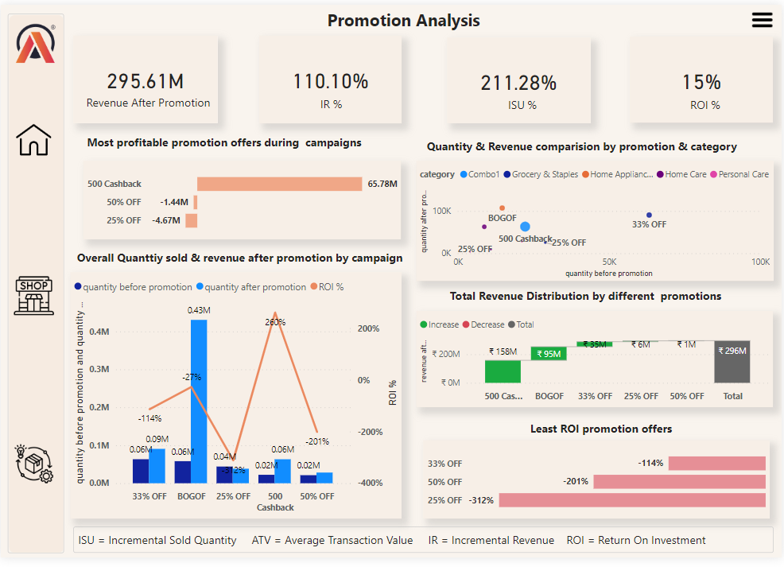
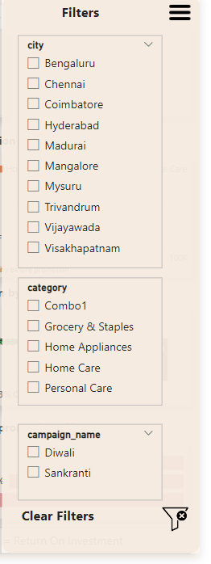
Dashboard Overview
This is Promotional analysis view.
AtliQ supermarket promotions & its Impact Analysis

Slide 11
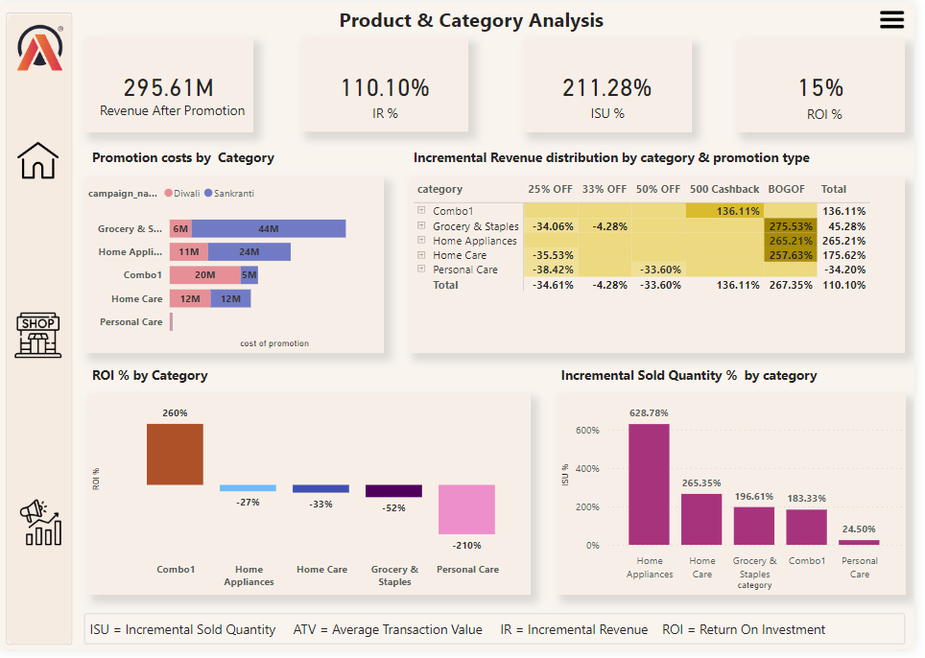
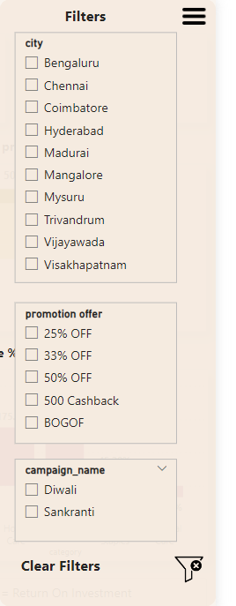
Dashboard Overview
This is Product & category analysis view of dashboard.
AtliQ supermarket promotions & its Impact Analysis

Slide 12
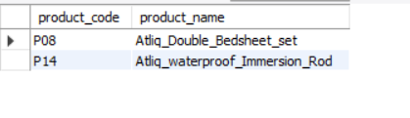
Ad-hoc Requests & insights generated from them
1) Provide a list of products with a base price greater than 500 and that are featured in promo type of ‘BOGOF’ (buy one get one free).
Ad hoc requests are not routine requests but more of requests addressed for specific needs or information which might be helpful going forward for business analysis.
Querying the database as per the requirement, we have 2 products having base price > 500 & promo of ‘’BOGOF’’ namely
Atliq double bedsheet set
2) Atliq waterproof immersion rod
AtliQ supermarket promotions & its Impact Analysis

Slide 13
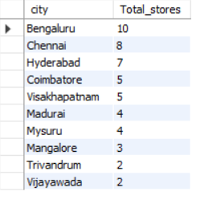
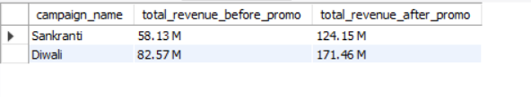
Ad-hoc Requests & insights generated from them
2) Generate report for total number of stores per city.
Bengaluru has the highest stores of Atliq which is 10 stores followed by Chennai & Hyderabad.
3) Generate report that shows campaigns along with its revenues. So we can get idea about the impact of campaigns on the revenue generated.
From the data we can get to know that there is a hike in revenue after the promotional campaigns both in Diwali & Sankranti.
AtliQ supermarket promotions & its Impact Analysis

Slide 14
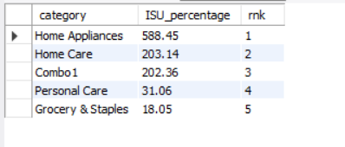
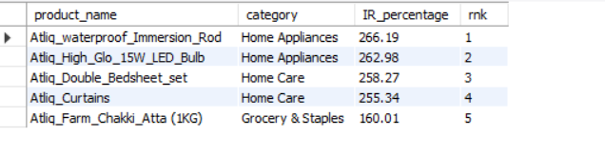
Ad-hoc Requests & insights generated from them
4) Create a report which calculates incremental sold quantity (ISU%) for each category during Diwali campaign.
Home appliances & home care categories have highest ISU% during Diwali campaign.
It means there was an increase in quantity of product sold for this 2 categories after promotions were applied.
5) Create a report containing top 5 products by incremental revenue % across all the campaigns.
This report helps us identify the products who had maximum promotion impact on them.
Home appliances of Atliq have a huge revenue increment across both the campaigns.
AtliQ supermarket promotions & its Impact Analysis

Slide 15
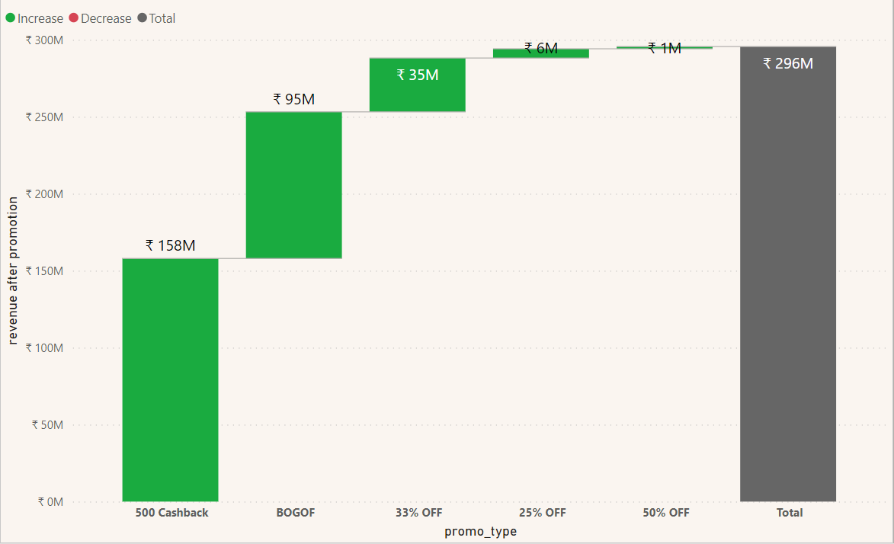
Other visualizations with insights & Recommendations
This visual gives us the overview about the promotional schemes contribution to the revenue generated after promotions applied.
A very important insight from this is 500 cashback is the most used promotional offer by the customers of Atliq followed by BOGOF.
AtliQ supermarket promotions & its Impact Analysis

Slide 16
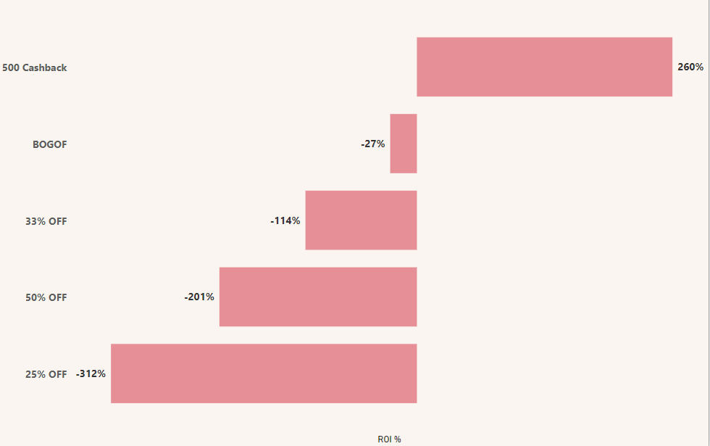
Other visualizations with insights & Recommendations
This visual gives us the overview about ROI% of different promotion types.
500 cashback is the most profitable promotional offer for Atliq with ROI % of 260%
AtliQ supermarket promotions & its Impact Analysis

Slide 17
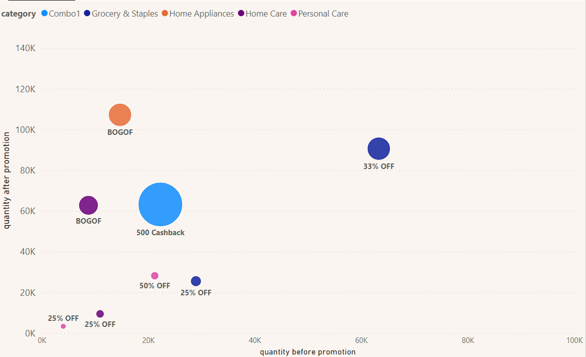
Other visualizations with insights & Recommendations
Bubbles represent different promotional types and size of bubble shows % revenue generated after promotions.
In this visual we can get idea about the increase in sales volume for different promotional types and the total revenue it generates after promotion.
AtliQ promotions & its Impact Analysis

Slide 18
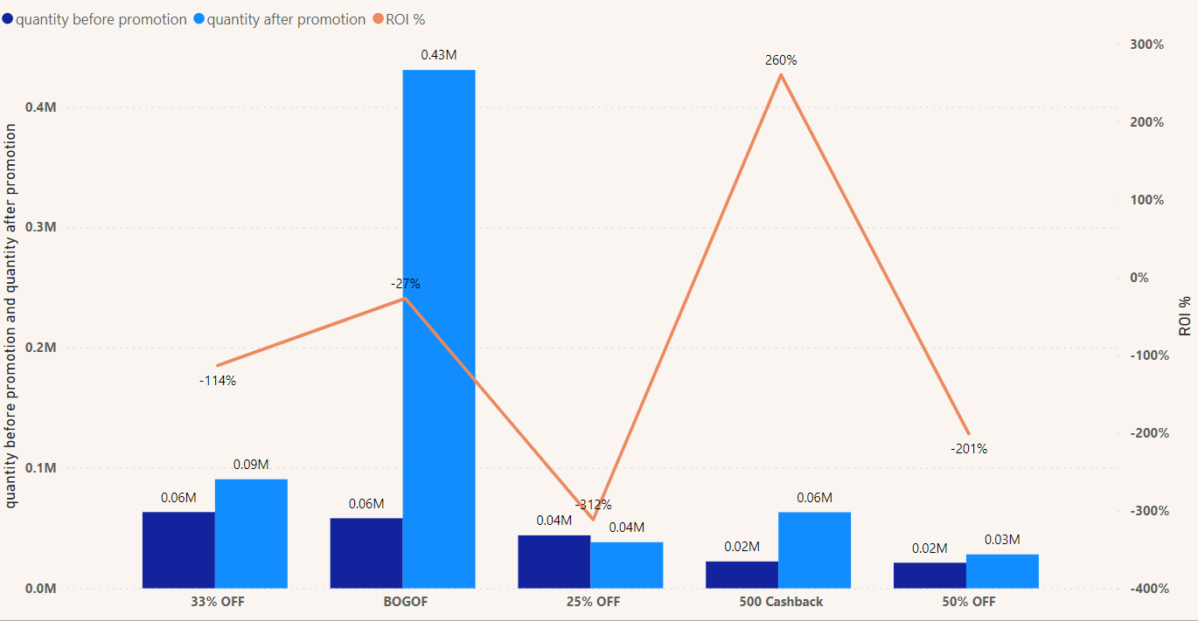
Other visualizations with insights & Recommendations
Even though there is rise in quantity sold after promo for BOGOF, the ROI% is still -27%.
For discount percentage based promotions, there is no such impact of this promotional offers on the increase in sales. 25% OFF promo is doing very poorly for Atliq with ROI% of -312% followed by 50% OFF with ROI of -201%.
AtliQ supermarket promotions & its Impact Analysis

Slide 19
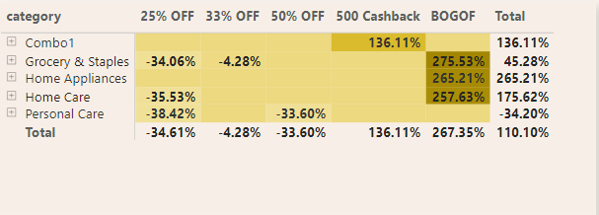
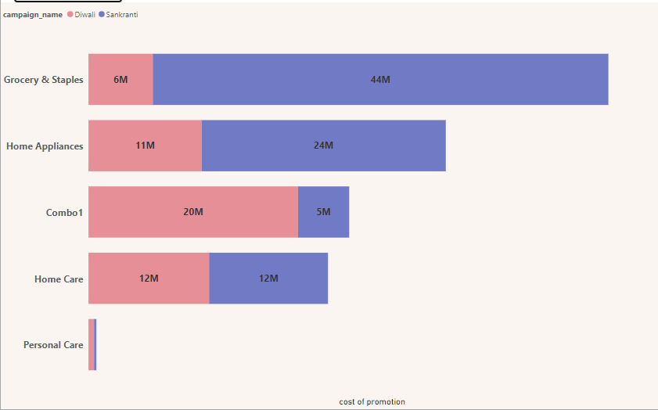
Other visualizations with insights & Recommendations
The cell values in matrix shows IR%
In the given matrix the cell values are IR% for different categories with their promotional offers.
The high intensity of color shows more Incremental revenue %.
Grocery & staples, home appliances, home care category of products with BOGOF offer had a massive promotion impact on them.
Home appliances have highest IR% of 265.21% & personal care products have lowest IR% of
-34.20%
25% OFF, 33% OFF & 50% OFF promo offers can’t create a buzz among the customers resulting in such low IR%.
Only 500 cashback & BOGOF promo offers were able to attract the customers during Diwali & sankranti campaigns.
Category wise cost of promotions for each campaigns
AtliQ supermarket promotions & its Impact Analysis

Slide 20
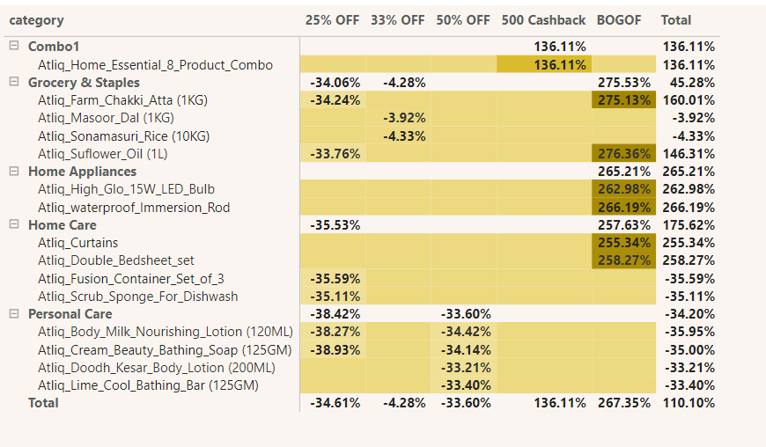
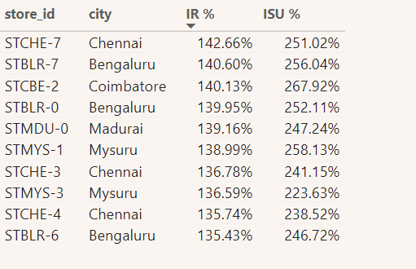
Other visualizations with insights & Recommendations
The cell values in matrix shows IR%
Atliq sunflower oil, Atliq farm chakki atta were the products which performed massively during BOGOF promotions.
This are the top 10 stores as per the incremental revenue %
Out of this 3 stores are from Bengaluru & Chennai each.
This show us the impact of promotional campaigns in this cities.
Also Bengaluru & Chennai have high amount of Atliq supermarket stores as compared to other cities.
Promotions on personal care products did not interest customers at all. As its revenue is less than revenue before promotions.
AtliQ supermarket promotions & its Impact Analysis

Slide 21
Recommendations
Atliq supermarket should focus on cashback promotion offers on its various products during next promotional period. As the response of the 500 cashback promo for combo1 was a big success. This are the promotions which give an instant feeling of benefit to customers.
Atliq should focus on bringing up IR% , ROI %, ISU% of cashback promotional offers as well as BOGOF as it attracts the customers more to buy the product compared to the discount percentage based promotions during festive period.
Atliq should make strategies to increase the ROI% for profitable returns for the business. This can be achieved by review of product, cost reduction measures, marketing & promotion strategies & any other plannings to bring the ROI% up for products.
BOGOF has increase in sales volume but the incremental revenue which it generates is less. So need to revisit the pricing of products, need to keep high margin products in BOGOF to bring incremental revenue to the business.

Slide 22
Recommendations
Bengaluru & Chennai contribute more than 40% of total revenue generated by Atliq supermarket. So Bengaluru & Chennai are the prime cities for Atliq’s business. Hence Atliq need to study about the customer demographics, purchasing behaviour, pricing of products, promos applied on this products in this 2 cities and use this information to grow business in other cities as well.
Personal care products have a negative IR%. They are not bringing additional revenue even after the promotional campaigns. So need to review promotional strategies for it, price adjustments, customer engagement initiatives, constant monitoring performance of this category is needed.
At last Atliq should perform a customer segmentation analysis on the basis of this two promotional campaigns of Diwali & Sankranti for their future promotional campaigns and make promotion strategies accordingly.

Slide 23
Thank you
Divya Mashruwala
dmashruwala87@gmail.com

